Slide 2
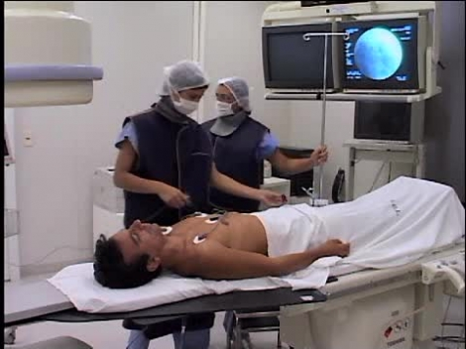

Slide 4
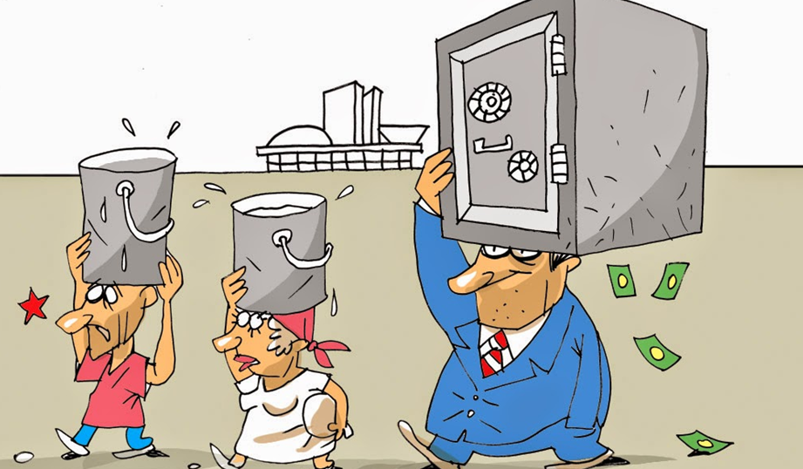

Slide 5
https://www.youtube.com/watch?v=8puudGRhfM0

Slide 6
https://www.youtube.com/watch?v=G46AIBIEitw

